Slide 1
Climatology of Traveling Waves in the Ensemble Mars Atmosphere Reanalysis System (EMARS)
Hart Gillespie
Advisor: Dr. Steven Greybush
The Pennsylvania State University
December 8, 2017

Slide 2
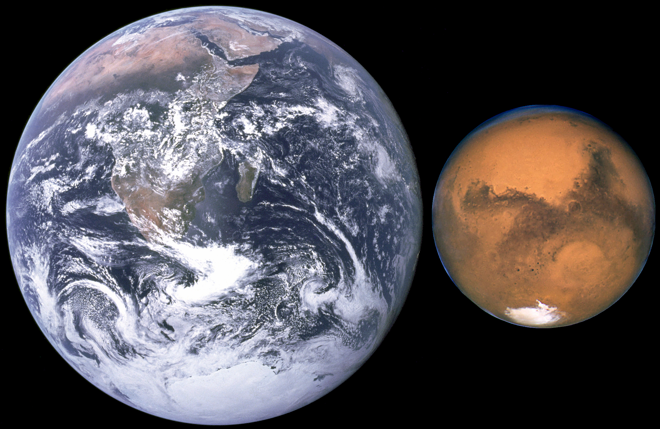
Martian Traveling Waves
Both Mars and Earth have traveling weather systems in winter
What can we learn from Mars’s Rossby waves?

Slide 3
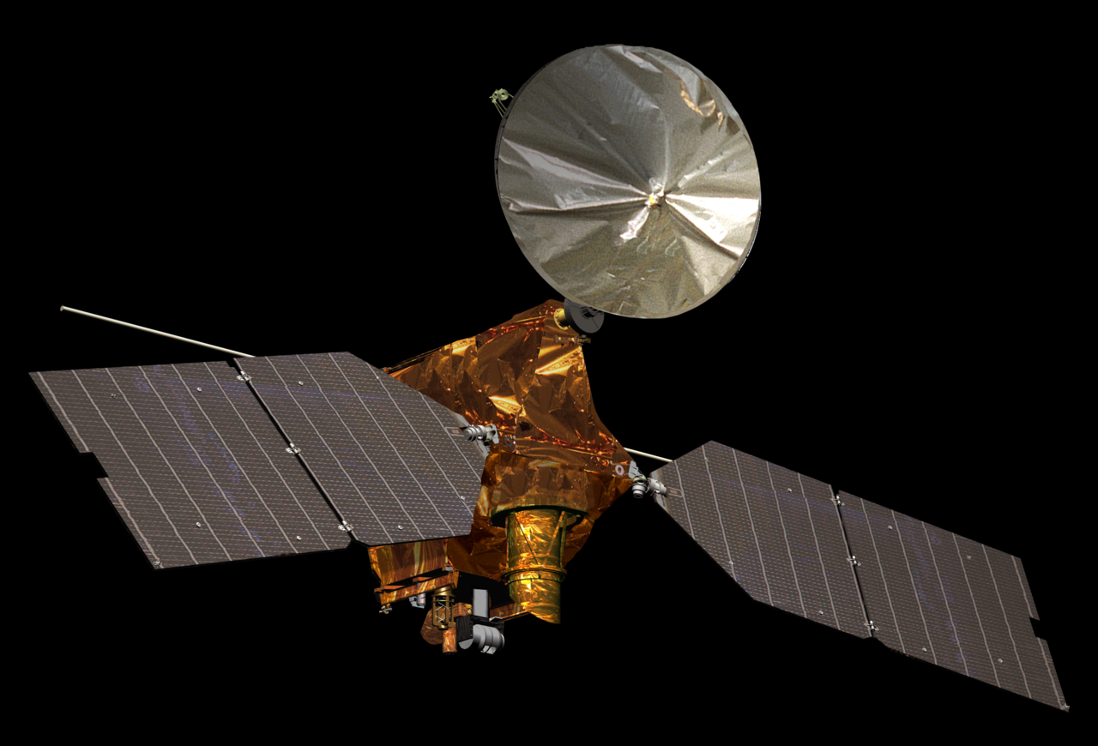
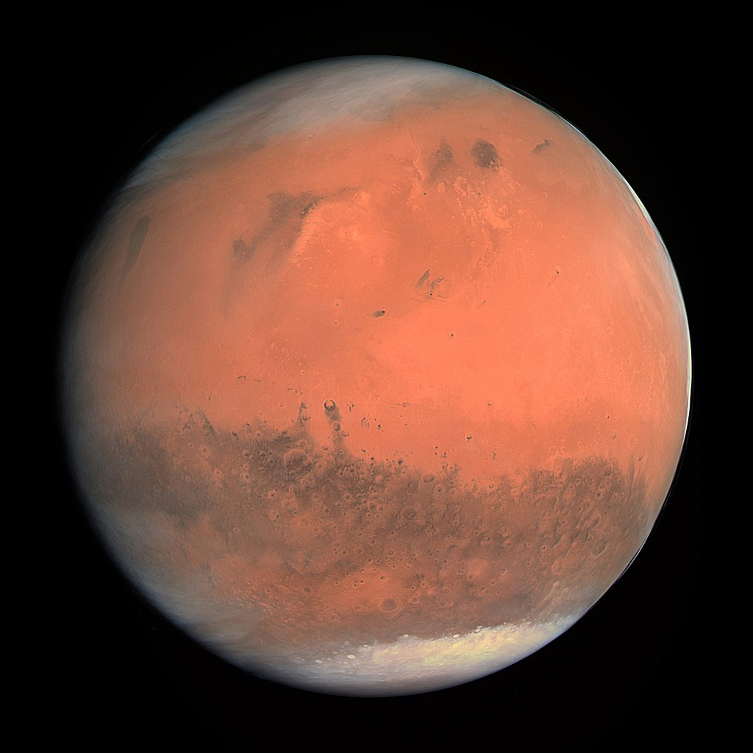
Observing Systems
Viking landers - pressure obs
Thermal Emission Spectrometer (TES)
Sun-synchronous nadir observer
Measures T, column dust and water
Mars Climate Sounder (MCS)
Sun-synchronous limb observer
Measures T, dust, water ice

Slide 4
Ensemble Mars Atmosphere Reanalysis System (EMARS)
Mars Global Circulation Model (MGCM)
150 km grid spacing
Nudge to observed dust in boundary layer
Local Ensemble Transform Kalman Filter (LETKF)
Update occurs once per hour
Ensemble members vary in dust and ice quantity
Uses temperature obs to update T, P, U, V

Slide 5
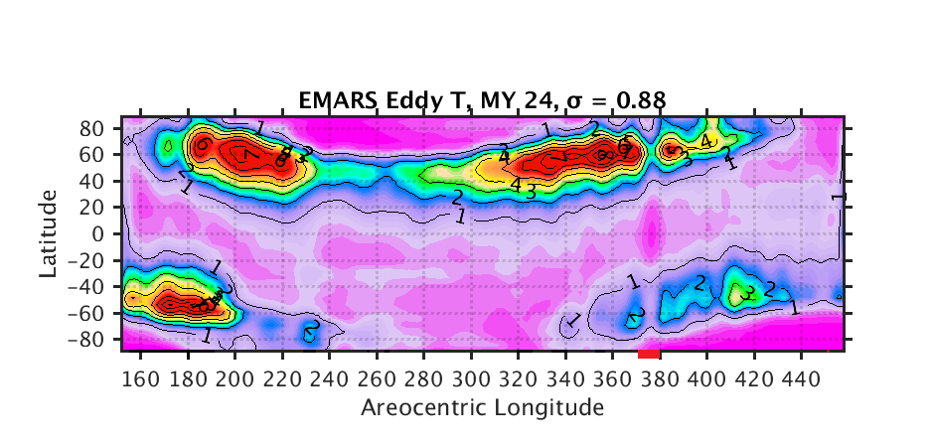
Comparison of EMARS with existing models

Slide 6
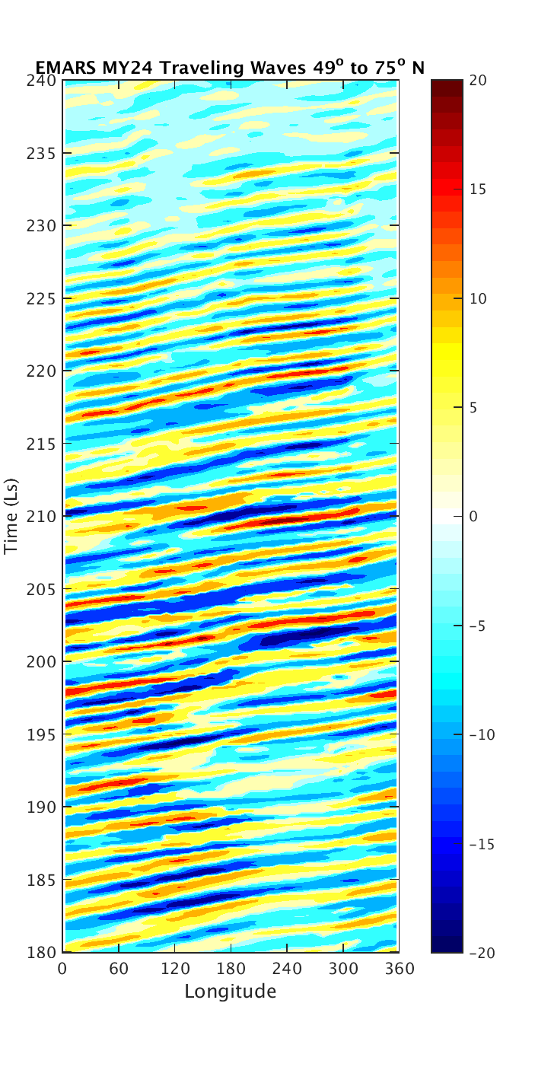
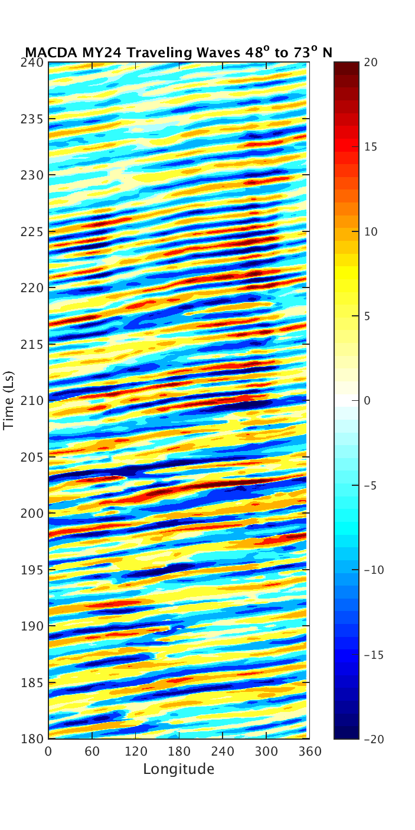
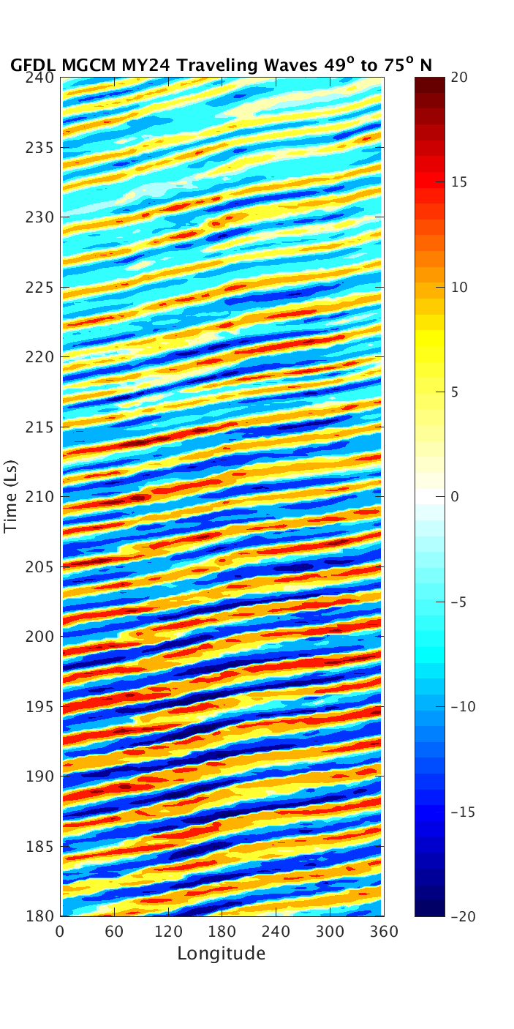
Comparison of EMARS with existing models

Slide 7
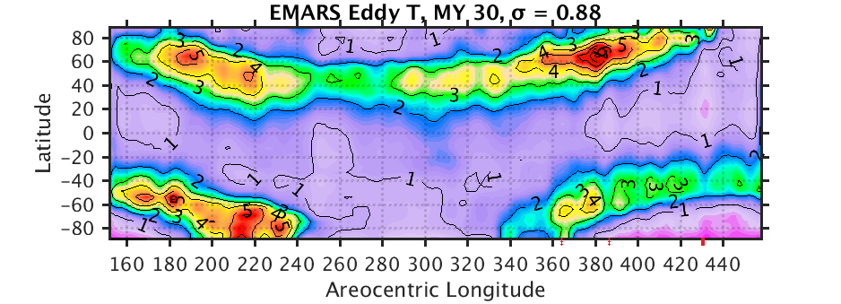
Comparison of TES and MCS years

Slide 8
Comparison of representative ensemble members

Slide 9
Conclusions and Future Work
Nadir observations are more suitable for analysis of traveling waves than limb observations
Predictability of Martian traveling waves
Aerosol assimilation

Slide 10
Acknowledgments
NASA Mars Data Analysis Program (MDAP) Grant NNX14AM13G
Dr. Steven Greybush
Dr. John Wilson

